Slide 1


Sarpong Kwadwo Asare
June 29, 2023

Slide 2

Outline
Executive Summary
Introduction
Methodology
Results
Conclusion
Appendix

Slide 3
Executive Summary
This data science project aimed to analyze and classify successful landings of SpaceX rockets. Data collected from the public SpaceX API and the SpaceX Wikipedia page. Various data exploration techniques, including SQL queries, visualizations, folium maps, and dashboards, were implemented.
Four machine learning models were used; Logistic Regression, Support Vector Machine, Decision Tree Classifier, and K Nearest Neighbors. Models yielded comparable results, achieving an accuracy rate of approximately 83.33%. However, it should be noted that all models tended to over-predict successful landings.
To improve the accuracy and robustness of the models, it is recommended to gather additional data. Increasing the dataset size will likely provide a more accurate determination of successful landings and reduce the tendency for over-prediction.

Slide 4
Introduction
The primary objective of this capstone project is to accurately predict the successful landing of the Falcon 9 first stage. SpaceX takes pride in their ability to reuse the first stage of their rocket launches, which significantly reduces costs. They advertise on their website that their rocket launches cost only $62 million, while other providers charge upwards of $165 million. The reusability of the first stage plays a crucial role in achieving these substantial savings. By determining whether the first stage will land successfully, we can accurately estimate the cost of a launch. This information becomes particularly relevant if an alternate company intends to compete with SpaceX for a rocket launch.
With this context in mind, our main research question revolves around predicting the outcome of the first stage landing for a given set of features pertaining to a Falcon 9 rocket launch. Our aim is to provide insights and predictions that can aid in decision-making processes, ultimately allowing companies to make informed bids when competing against SpaceX.

Slide 5

Section 1

Slide 6
Methodology
Executive Summary
Data collection methodology:
Data was combined from both the SpaceX API and the SpaceX Wikipedia page
Perform data wrangling
Tasked with classifying true landings as successful or otherwise
Perform exploratory data analysis (EDA) using visualization and SQL
Perform interactive visual analytics using Folium and Plotly Dash
Perform predictive analysis using classification models
Models were tuned using GridSearchCV

Slide 7
Data Collection
The data collection process involved a combination of API requests from the SpaceX public API and web scraping data from a table in SpaceX's Wikipedia entry.
The API data collection flowchart will be presented on the next slide, followed by the web scraping data collection flowchart on the subsequent slide
Columns used in SpaceX API Data
FlightNumber, Date, BoosterVersion, PayloadMass, Orbit, LaunchSite, Outcome, Flights, GridFins,Reused, Legs, LandingPad, Block, ReusedCount, Serial, Longitude, Latitude
Wikipedia Web Scraping Data Columns
Flight No., Launch site, Payload, PayloadMass, Orbit, Customer, Launch outcome, Version Booster, Booster landing, Date, Time

Slide 8
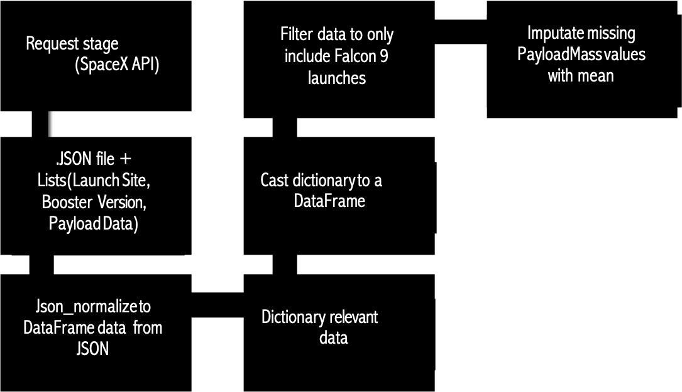
Data Collection – SpaceX API
https://github.com/skayasare/IBM-Data-Science-CapProject/blob/main/Data%20Collection.ipynb

Slide 9



Data Collection - Scraping
Wikipedia html
request
Cast dictionary to DataFrame
https://github.com/skayasare/IBM-Data-Science-CapProject/blob/main/Web%20Scrapping.ipynb
Parse
BeautifulSoup
html5lib
Extract data to
dictionary by
iterating through
cells
Find info
from launch
html table
Create dictionary

Slide 10
Data Wrangling
Create a training label with landing outcomes based on success and failure:
Successful landings are assigned a value of 1.
Failed landings are assigned a value of 0.
The Outcome column consists of two components: 'Mission Outcome' and ‘Landing Location’.
New Training Label Column.
Introduce a new training label column called 'class’.
Assign a value of 1 to 'class' if the 'Mission Outcome' is True.
Assign a value of 0 to 'class' otherwise.
Value Mapping
Mapping of 'Mission Outcome' and 'Landing Location' to 'class':
If 'Mission Outcome' is True and Landing Location is True ASDS, True RTLS, or True Ocean, assign 'class' as 1.
If 'Mission Outcome' is False or Landing Location is None None, False ASDS, None ASDS, False Ocean, or False RTLS, assign 'class' as 0.
Github url
https://github.com/skayasare/IBM-Data-Science-CapProject/blob/main/Data%20Wrangling.ipynb

Slide 11
EDA with Data Visualization
EDA performed on features: Flight Number, Payload Mass, Launch Site, Orbit, Class, and Year.
Plots Used:
Flight Number vs. Payload Mass
Flight Number vs. Launch Site
Payload Mass vs. Launch Site
Orbit vs. Success Rate
Flight Number vs. Orbit
Payload vs. Orbit Success Yearly Trend
Scatter plots, line charts, and bar plots were utilized to analyze relationships between variables.
Purpose of the analysis was to determine the presence of relationships for potential use in training the machine learning model.
Github url
https://github.com/skayasare/IBM-Data-Science-CapProject/blob/main/EDA%20with%20Visualization.ipynb

Slide 12
EDA with SQL
Some queries performed are as follows:
Displaying the unique launch site names in the space mission.
Displaying 5 records where the launch sites begin with the string 'CCA'.
Displaying the total payload mass carried by boosters launched by NASA (CRS).
Displaying the average payload mass carried by booster version F9 v1.1.
Listing the date when the first successful landing outcome on the ground pad was achieved.
Listing the names of the boosters that successfully landed on a drone ship and had a payload mass greater than 4000 but less than 6000.
Listing the total number of successful and failed mission outcomes.
Listing the names of the booster versions that carried the maximum payload mass.
Listing the failed landing outcomes on a drone ship, including their booster versions and launch site names for the year 2015.
Ranking the count of landing outcomes between the dates 2010-06-04 and 2017-03-20 in descending order.
https://github.com/skayasare/IBM-Data-Science-CapProject/blob/main/EDA%20With%20SQL.ipynb

Slide 13
Build an Interactive Map with Folium
Folium maps used to mark Launch Sites, successful and unsuccessful landings, and proximity to key locations such as Railway, Highway, Coast, and City.
Purpose:
Gain insights into the rationale behind the selection of launch site locations and visualize the distribution of successful landings in relation to these locations.
By examining the maps, we can understand the factors influencing launch site placement and observe the spatial relationship between successful landings and their surrounding areas.
Github url
https://github.com/skayasare/IBM-Data-Science-CapProject/blob/main/Launch%20Sites%20Locations%20Analysis%20with%20Folium.ipynb

Slide 14
Build a Dashboard with Plotly Dash
The dashboard consists of a pie chart and a scatter plot.
The pie chart provides two selectable options:
Overall distribution of successful landings across all launch sites.
Individual launch site success rates.
The scatter plot incorporates two inputs:
Launch site selection (all sites or individual site).
Payload mass on a slider, ranging from 0 to 10,000 kg.
The pie chart is used to visually represent the success rate of launch sites.
The scatter plot allows us to observe variations in success rates across launch sites, payload mass, and booster version categories.
https://github.com/skayasare/IBM-Data-Science-CapProject/blob/main/spacex_dash_app.py

Slide 15
Predictive Analysis (Classification)
https://github.com/skayasare/IBM-Data-Science-CapProject/blob/main/Machine%20Learning%20Prediction.ipynb
From dataset,
split the column ‘Class’
Plot Confusion
Matrix for all models
Evaluate models on test data
Feature transform
and fit using StandardScaler
Visualize model performance with bar chat
GridSearchCV on prediction models
GridSearchCV (n=10) to find parameters
Split data into train and test

Slide 16
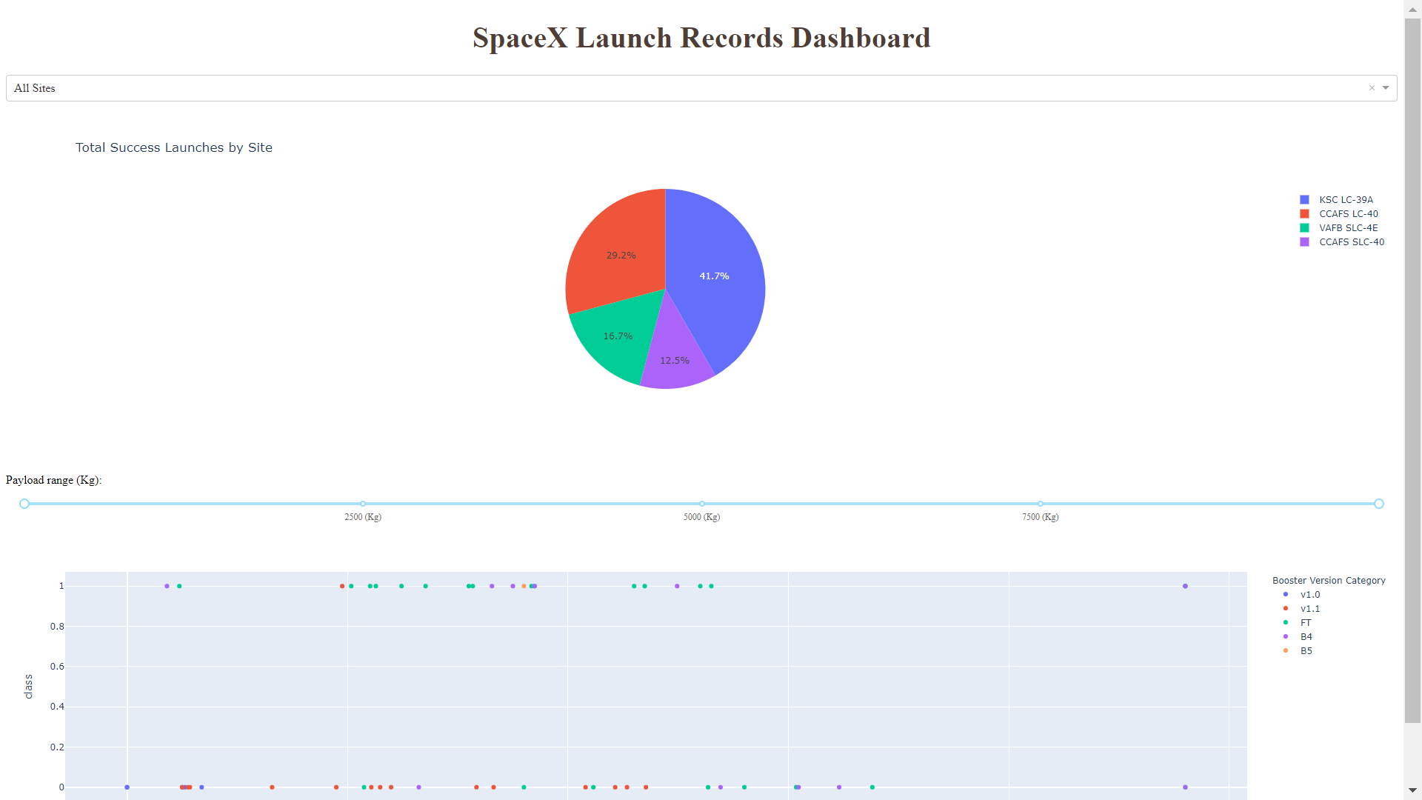
Results
This slide provides a preview of the Plotly dashboard.
Subsequent slides will showcase the results of different analyses and visualizations.

Slide 17

Section 2

Slide 18
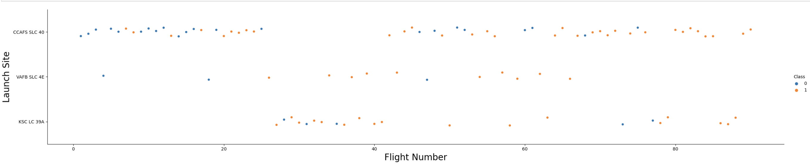
Flight Number vs. Launch Site
Orange = successful launch, Blue = unsuccessful launch
The graphical representation indicates a notable improvement in success rates over time, as indicated by the Flight Number. There seems to be a significant breakthrough around flight 20, resulting in a substantial increase in the success rate. It is evident that CCAFS is the primary launch site, given its high volume of launches.

Slide 19
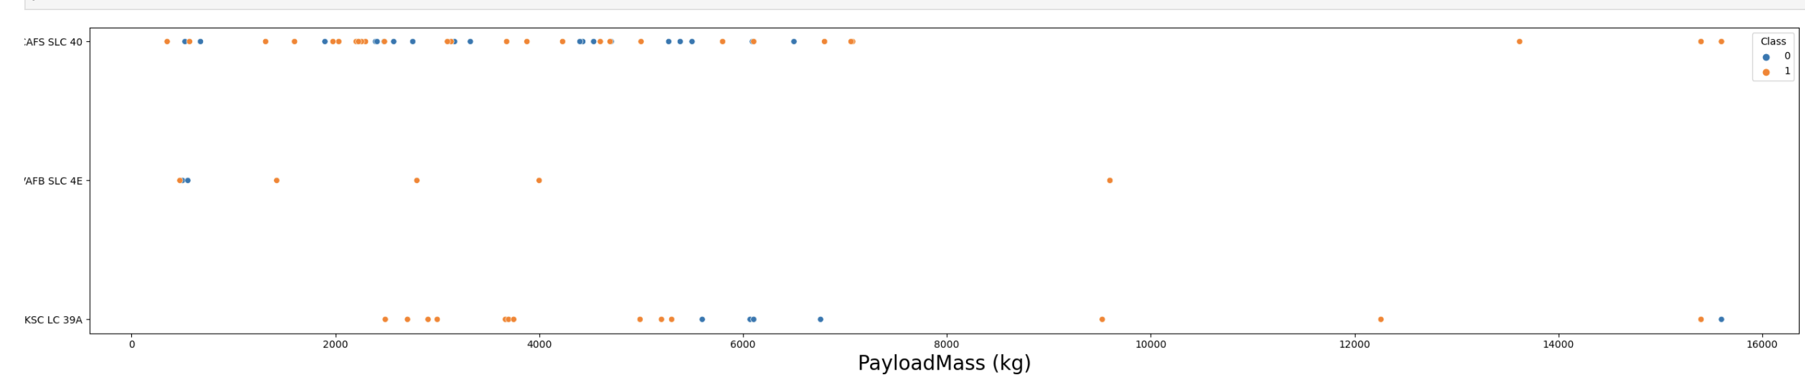
Payload vs. Launch Site
Orange = successful launch, Blue = unsuccessful launch
The majority of payload masses typically range from 0 to 6000 kg. Furthermore, various launch sites exhibit variations in the payload masses they handle.

Slide 20
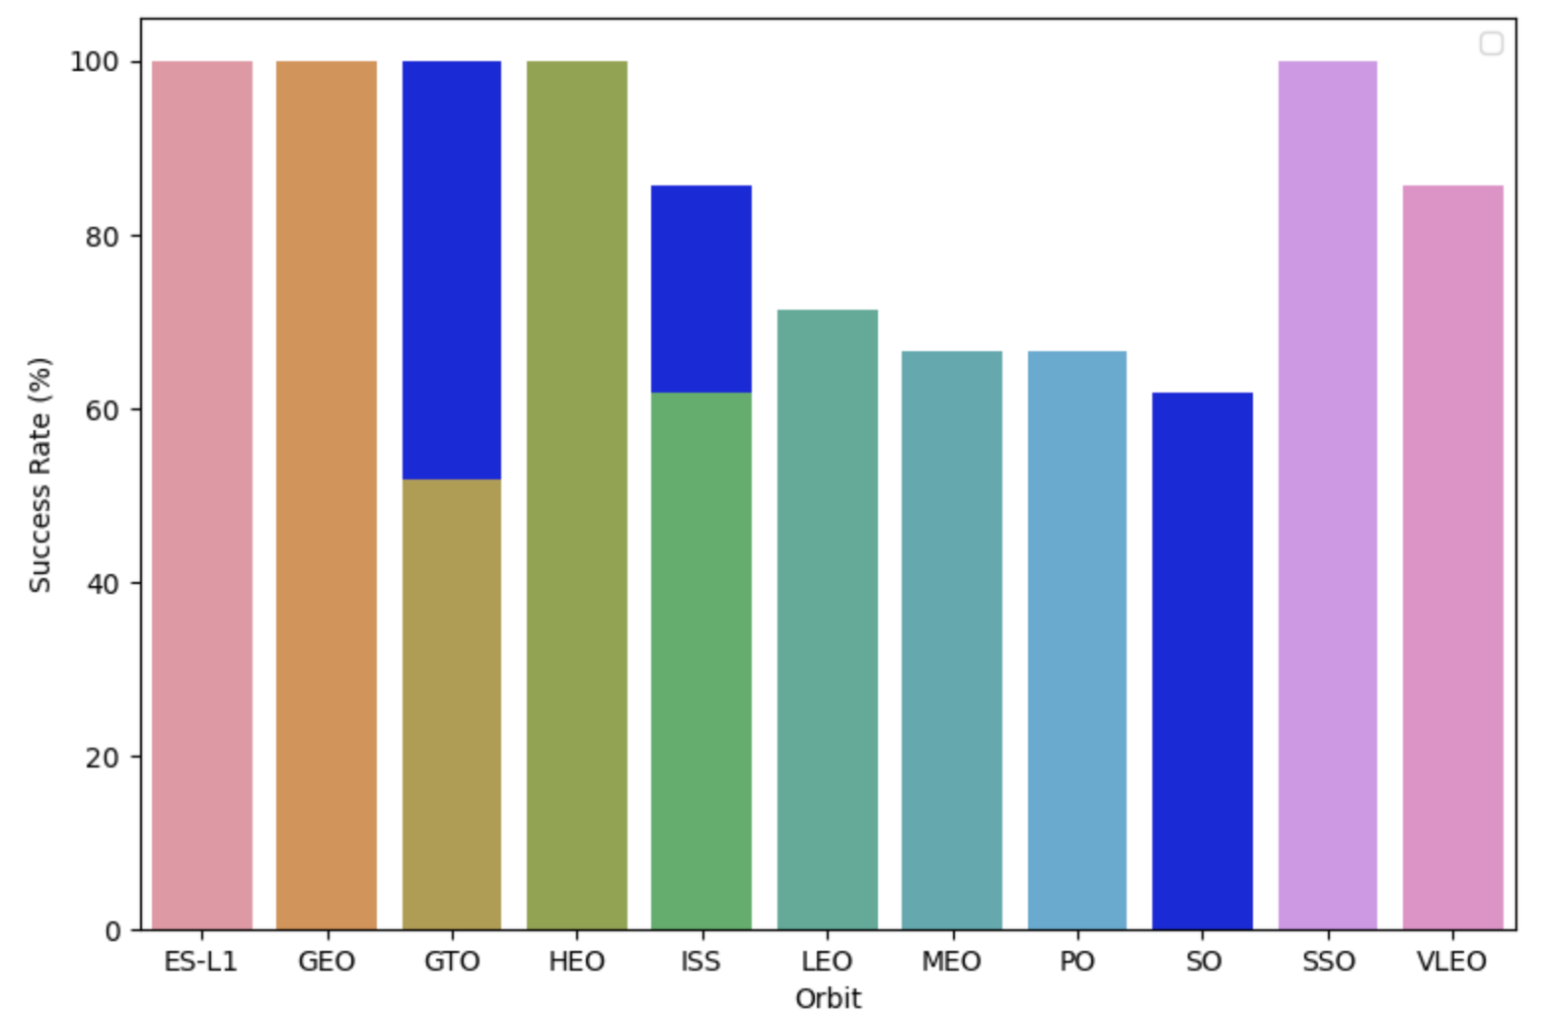
Success Rate vs. Orbit Type
ES-L1, GEO, HEO have a 100% success rate based on the provided sample sizes (1).
SSO, with a sample size of 5, also boasts a perfect success rate.
VLEO, with a larger sample size of 14, demonstrates a decent success rate and has seen several successful attempts.
Unfortunately, SO, with a sample size of 1, has experienced a 0% success rate.
GTO, which has the largest sample size of 27, exhibits an approximate 50% success rate.
Success Rate Scale: 0 -> 0%, 0.6 -> 60%, 1 -> 100%

Slide 21
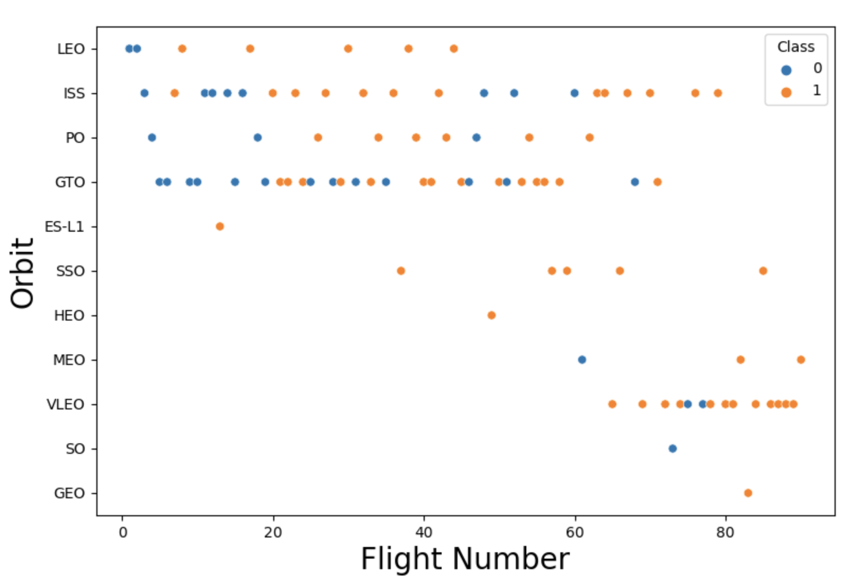
Flight Number vs. Orbit Type
Orange = successful launch, Blue = unsuccessful launch
The preference for launch orbits varied throughout the flight numbers.
There is a correlation between launch outcome and the chosen orbit preference.
Initially, SpaceX started with LEO (Low Earth Orbit) orbits, which experienced moderate success.
Afterward, SpaceX shifted back to VLEO (Very Low Earth Orbit) in recent launches.
SpaceX seems to achieve better results in lower orbits or Sun-synchronous orbits.

Slide 22
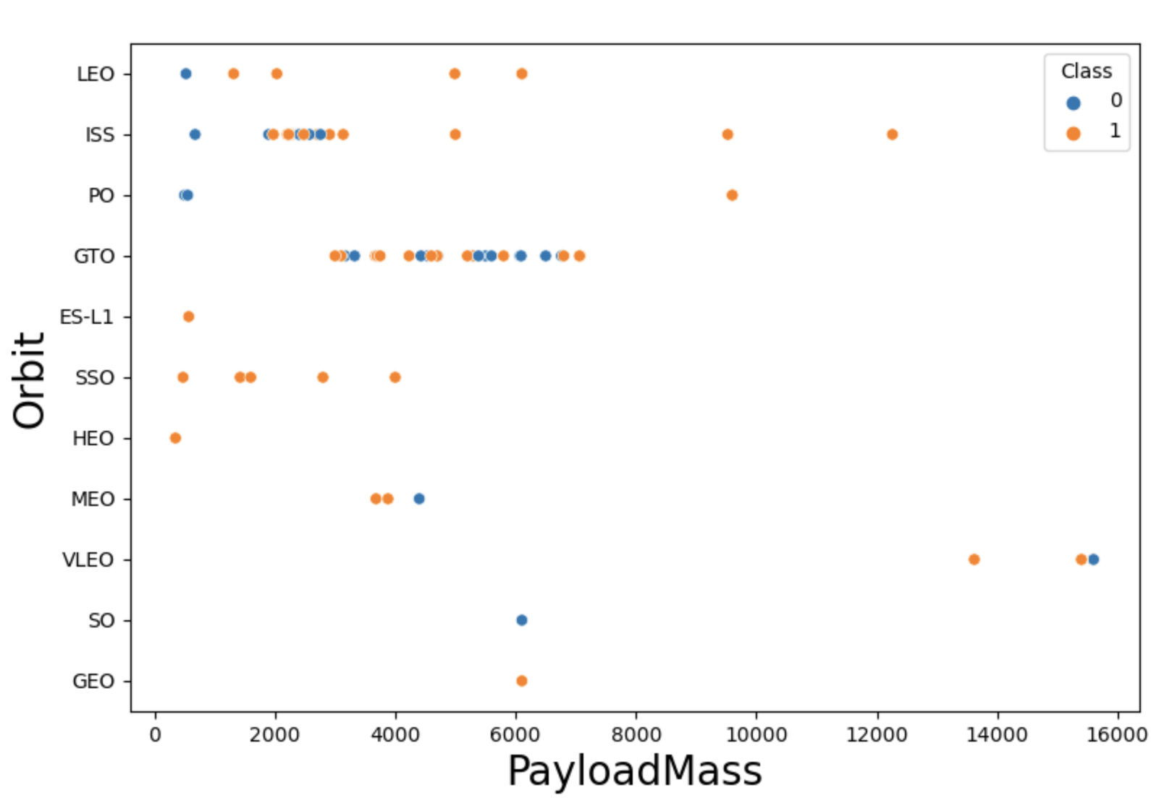
Payload vs. Orbit Type
Orange = successful launch, Blue = unsuccessful launch
There is a correlation between payload mass and the chosen orbit.
LEO (Low Earth Orbit) and SSO (Sun-Synchronous Orbit) tend to have relatively low payload mass.
On the other hand, VLEO (Very Low Earth Orbit), which is one of the most successful orbits, has payload mass values predominantly on the higher end of the range.

Slide 23
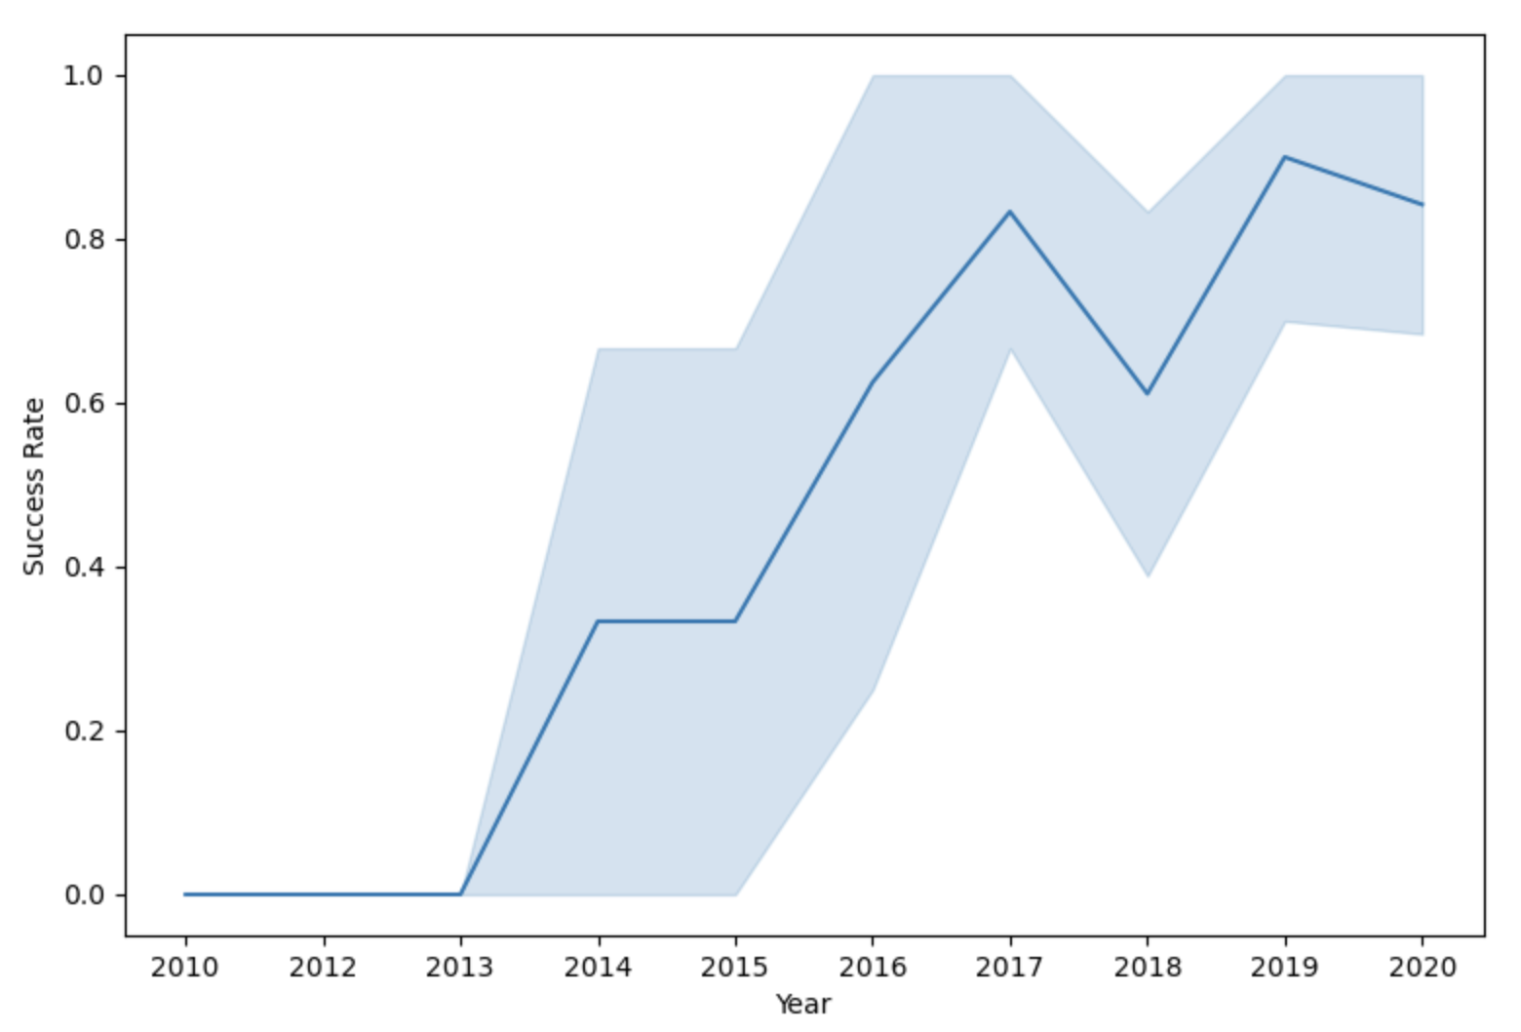
Launch Success Yearly Trend
The success rate of launches has shown a general upward trend since 2013, indicating an overall improvement.
There was a slight dip in success in 2018, suggesting a temporary setback.
In recent years, the success rate has stabilized at approximately 80%, indicating a consistently high level of achievement.

Slide 24
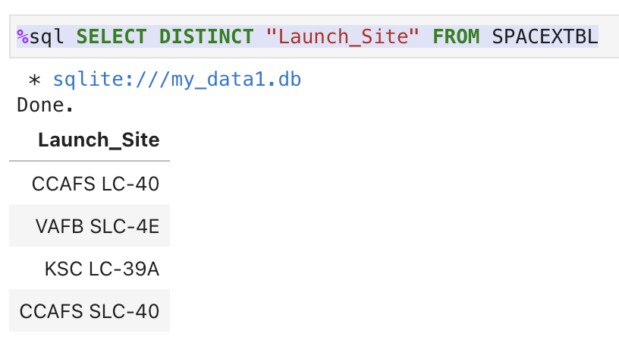
All Launch Site Names
A query of the database reveals several launch site names.
It appears that "CCAFS SLC-40" and "CCAFSSLC-40" likely represent the same launch site but with data entry errors.
The previous name for this site was "CCAFS LC-40.”
Based on the available information, there are likely only three unique launch site values: "CCAFS SLC-40," "KSC LC-39A," and "VAFB SLC-4E."

Slide 25
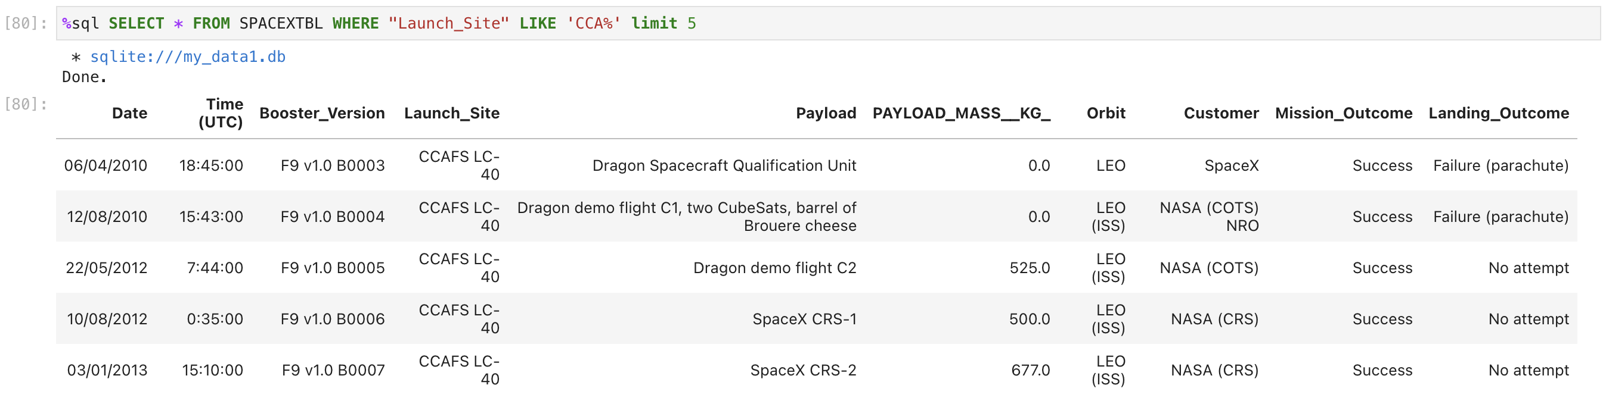
Launch Site Names Begin with 'CCA'
Upon examining the database, the first five entries with launch site names beginning with "CCA" are as follows:
CCAFS SLC-40
CCAFS SLC-40
CCAFS LC-40
CCAFS SLC-40
CCAFS LC-40

Slide 26
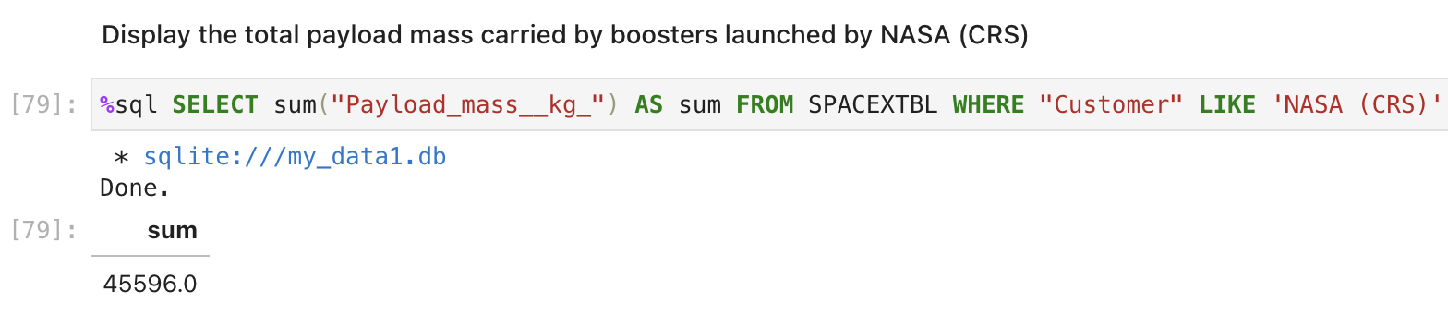
Total Payload Mass
The provided query calculates the total payload mass in kilograms for missions where NASA served as the customer.
The abbreviation "CRS" represents Commercial Resupply Services, indicating that these payloads were specifically sent to the International Space Station (ISS) as part of resupply missions.

Slide 27
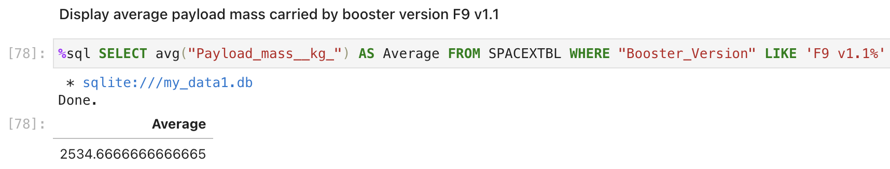
Average Payload Mass by F9 v1.1
The given query calculates the average payload mass for launches that utilized the booster version F9 v1.1.
It is observed that the average payload mass of F9 v1.1 falls on the lower end of the payload mass range considered.
This suggests that, on average, F9 v1.1 missions tend to handle payloads with relatively lower masses compared to other launch configurations.

Slide 28
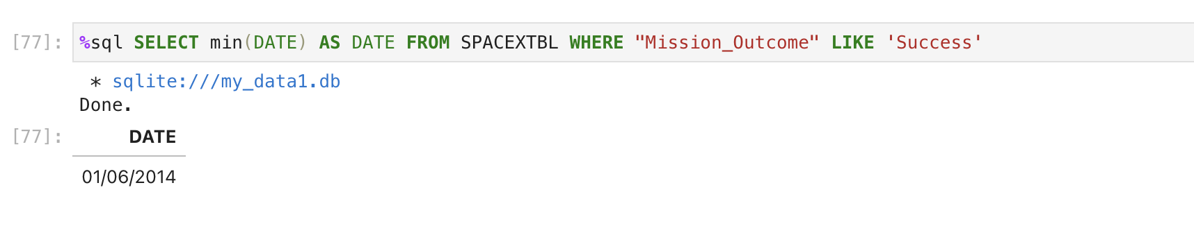
First Successful Ground Landing Date
The executed query provides the date of the first successful ground pad landing.
It is noteworthy that the initial successful ground pad landing did not occur until mid 2014

Slide 29
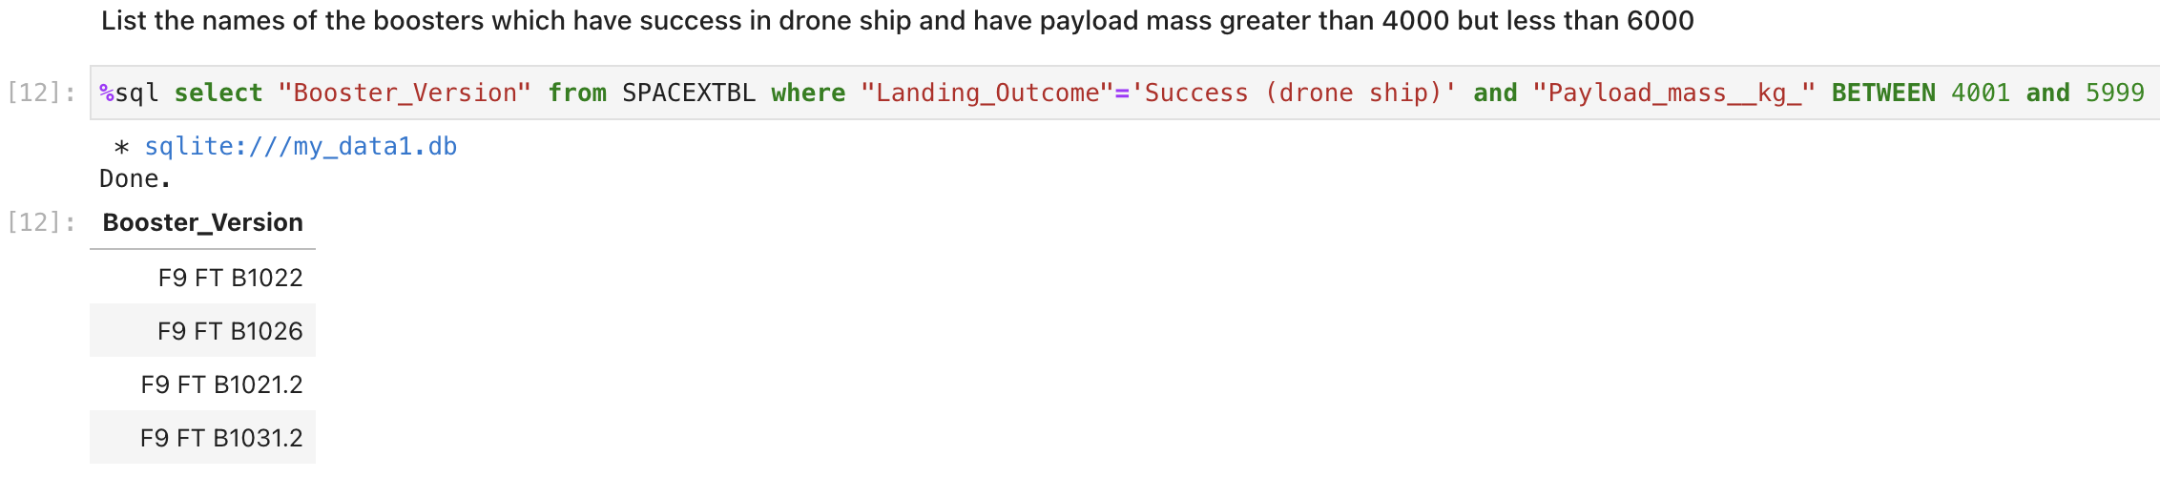
Successful Drone Ship Landing with Payload between 4000 and 6000
The query retrieves four booster versions that achieved successful drone ship landings and had a payload mass falling between 4000 and 6000 (excluding the endpoints).

Slide 30
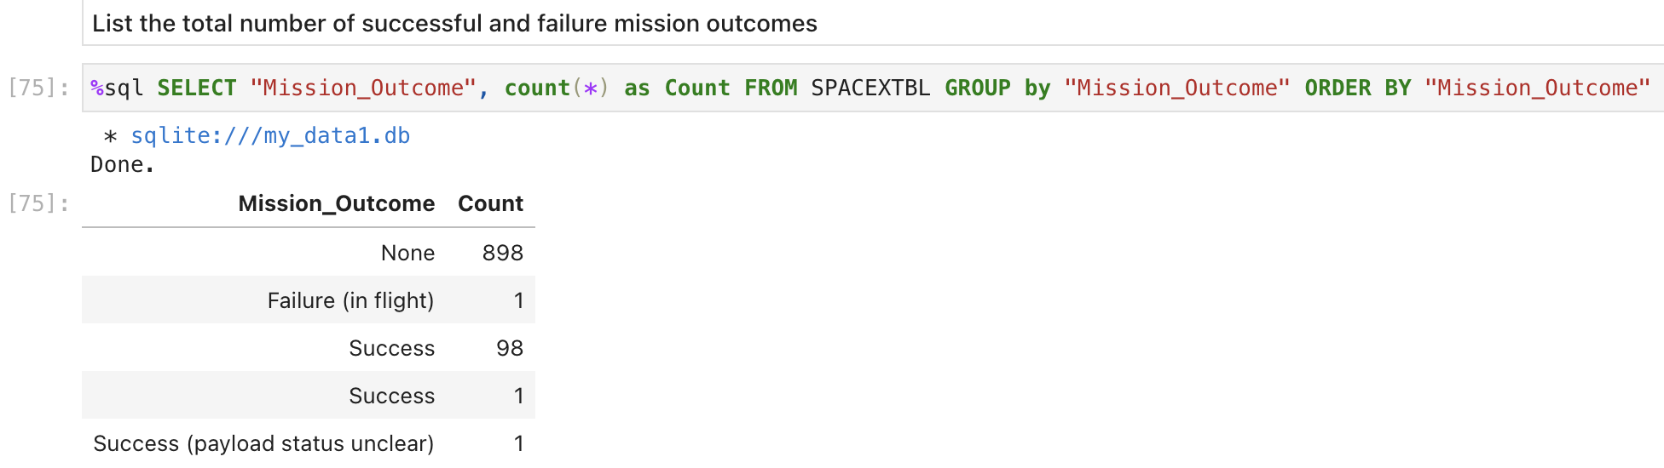
Total Number of Successful and Failure Mission Outcomes
The query provides a count of each mission outcome.
SpaceX demonstrates an impressive success rate, achieving its mission outcome in nearly 99% of the cases.
This suggests that the majority of landing failures are actually intentional, serving as part of experimental or testing procedures.
Notably, there is one launch with an unclear payload status, indicating a lack of definitive information regarding its outcome.
Unfortunately, there has been one recorded failed in-flight mission, highlighting a rare instance of unsuccessful mission execution

Slide 31
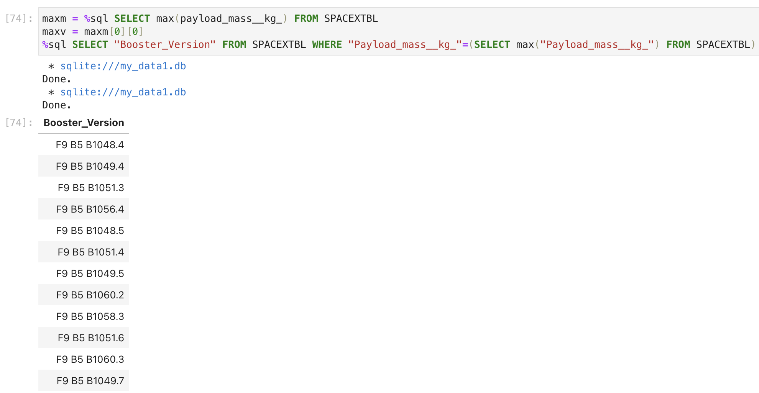
Boosters Carried Maximum Payload
The query identifies the booster versions that transported the highest payload mass, which amounted to 15600 kg.
Remarkably, these booster versions share remarkable similarities, all belonging to the F9 B5 B10xx.x variety.
This strong correlation suggests that the choice of booster version is closely linked to the payload mass being carried.

Slide 32
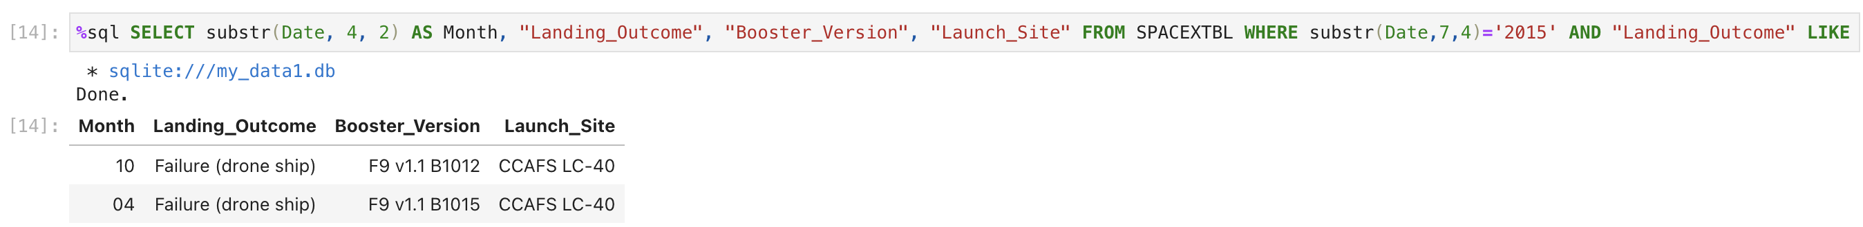
2015 Launch Records
The query provides information on 2015 launches, specifically focusing on the Month, Landing Outcome, Booster Version, Payload Mass (in kg), and Launch Site.
The query filters the results to include cases where the stage 1 failed to land on a drone ship.
Notably, there were two instances of such occurrences during that year.

Slide 33
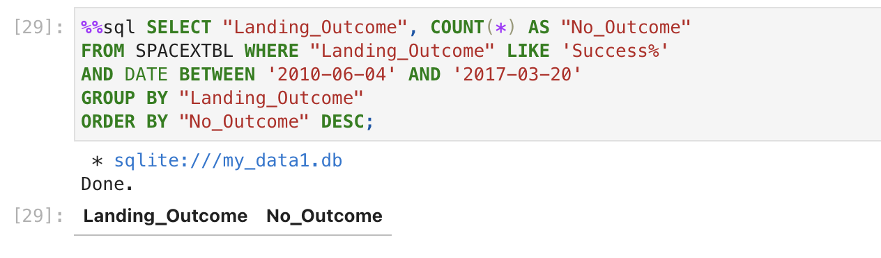
Rank Landing Outcomes Between 2010-06-04 and 2017-03-20
It appears the above query execution returns no results

Slide 34

Section 3

Slide 35
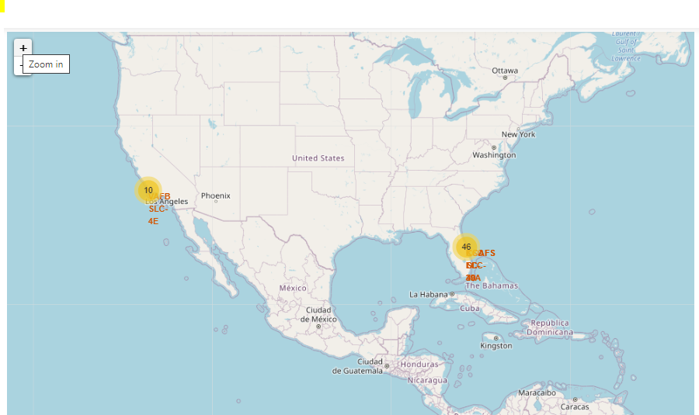
SpaceX Launch Sites Locations
The yellow markers on the map indicate the locations of SpaceX launch sites across the United States.
These launch sites have been strategically positioned near coastal areas for optimal operational advantages.

Slide 36

Color Launch Markers
The clusters on the Folium map can be interacted with by clicking on them.
Clicking on a cluster reveals individual markers representing successful landings (green icon) and failed landings (red icon).
In the provided example, VAFB SLC-4E is highlighted, displaying 4 successful landings and 6 failed landings.

Slide 37
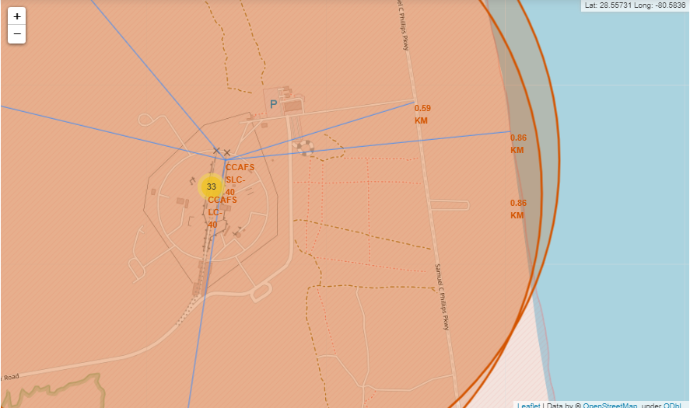
Key Launch Site Proximities
From the map, launch sites are strategically situated in close proximity to railways, enabling efficient transportation of large components and supplies.
Additionally, the launch sites are conveniently located near highways
Another notable observation is that the launch sites are positioned near coastal regions, ensuring that launch failures can safely land in the sea instead of densely populated areas.
This careful selection of launch site locations helps minimize the risk of rockets falling on highly populated areas while maximizing operational efficiency.

Slide 38

Section 4

Slide 39
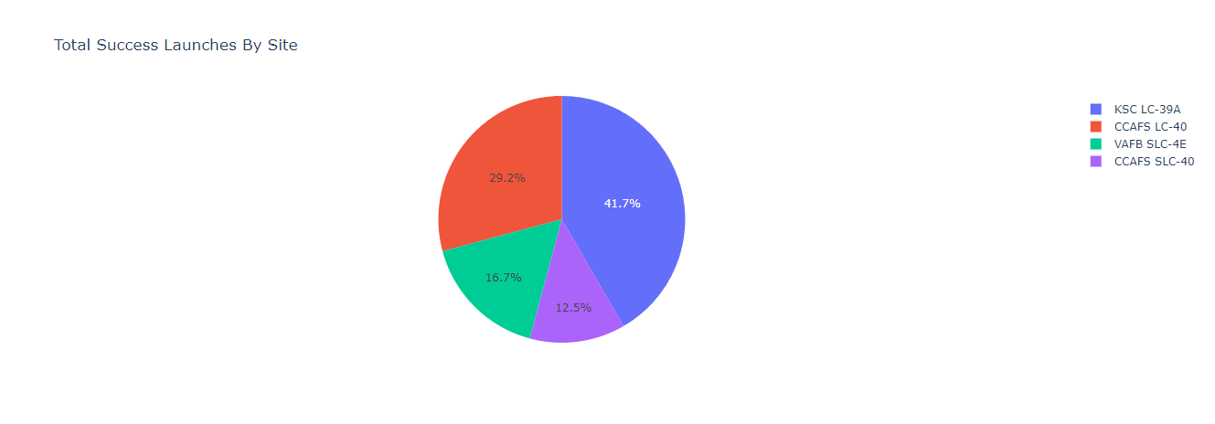
Total Successful Launches By Site
The distribution chart showcases the number of successful landings across different launch sites. CCAFS LC-40 and KSC have an equal number of successful landings. VAFB has the smallest share of successful landings. This could be attributed to a smaller sample size and the increased difficulty of launching from the west coast.

Slide 40
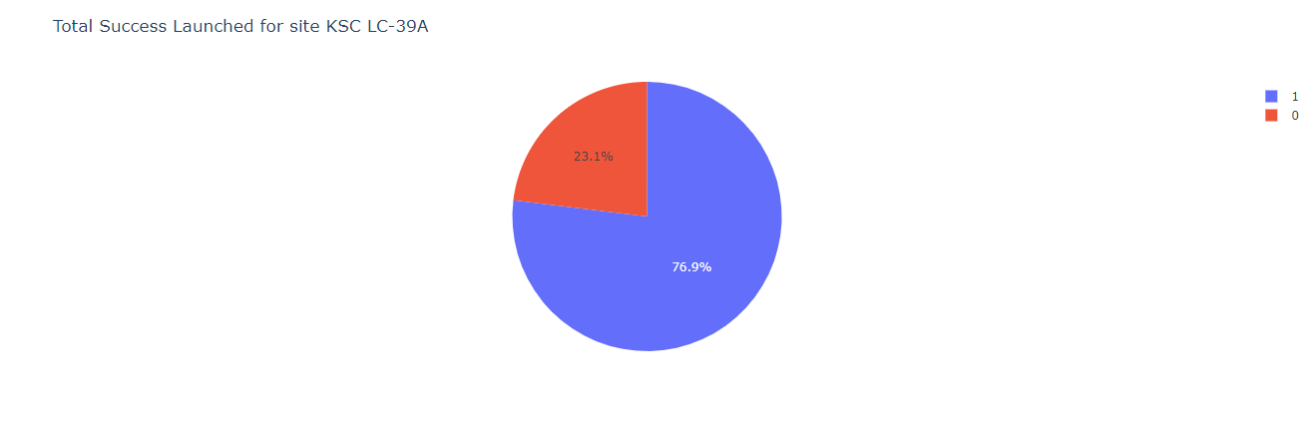
Highest Success Ratio Launch Site
KSC LC-39A has the highest success rate with 10 successful landings and 3 failed landings

Slide 41
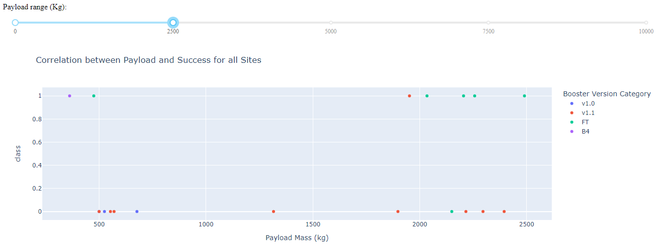
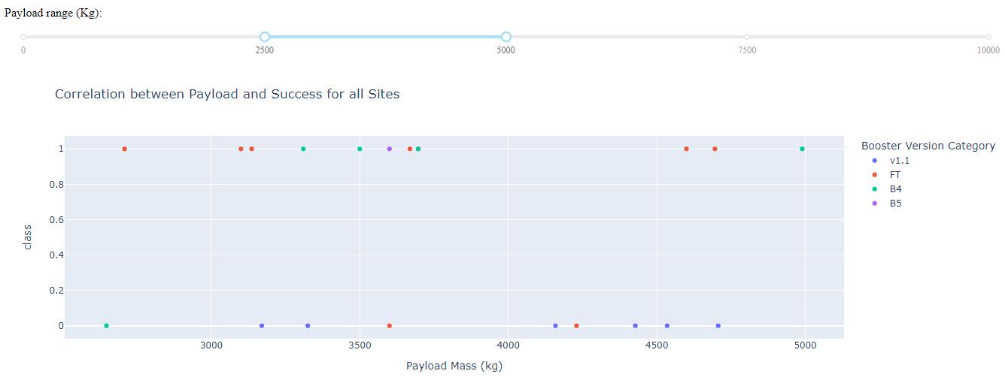
Payloads vs Launch Outcome
The launch success rate for payloads in the 0-2500 kg range is slightly lower than that of payloads in the 2500-5000 kg range. However, the difference between the two success rates is minimal.
Interestingly, there is not a significant disparity between the success rates of these payload categories.
Furthermore, it is notable that there is a specific booster version that exhibits the highest success rate.

Slide 42

Section 5

Slide 43
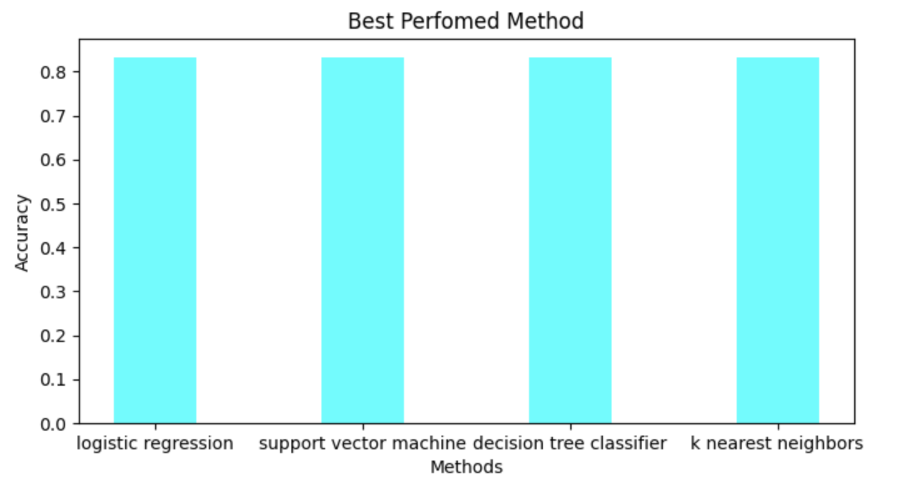
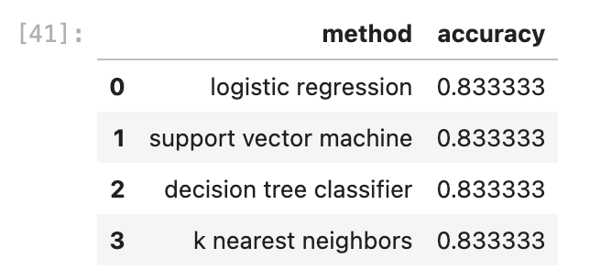
Classification Accuracy
Across all models, the test set demonstrated a nearly identical accuracy level, achieving an accuracy rate of 83.33%.
It is important to consider that the test size was relatively small, with a sample size of only 18.
Such a limited sample size can lead to significant variance in accuracy results, as observed in the Decision Tree Classifier model during repeated runs.
To determine the most suitable model, it is advisable to gather additional data, allowing for a more comprehensive analysis and evaluation.

Slide 44
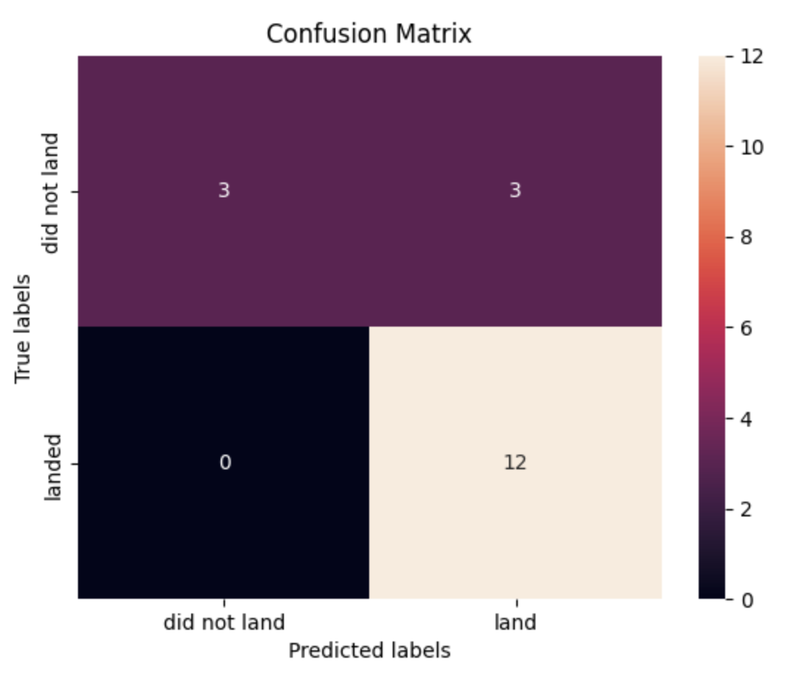
Confusion Matrix
As all models performed similarly on the test set, the confusion matrix remained consistent across all models.
The models correctly predicted 12 successful landings when the true label indicated a successful landing.
Similarly, the models accurately predicted 3 unsuccessful landings when the true label indicated an unsuccessful landing.
However, it is important to note that the models also predicted 3 successful landings when the true label indicated unsuccessful landings, resulting in false positives.
This suggests that the models tend to overpredict successful landings, potentially indicating a bias towards positive outcomes.

Slide 45
Conclusions
The primary objective of the model was to predict the successful landing of Stage 1.
To accomplish this, we utilized data from a public SpaceX API and conducted web scraping from the SpaceX Wikipedia page.
A positive correlation was identified between the number of flights and the success rate.
Lighter payloads tend to have a higher success rate compared to heavier payloads.
The launch sites are strategically positioned near highways and railways, facilitating efficient transportation of personnel and cargo.
The best performing machine learning model we created demonstrated an impressive accuracy rate of 83%.
In conclusion, our machine learning model equips Space Y with a powerful tool to navigate the competitive space industry successfully. Through ongoing data collection and model refinement, we can continuously enhance our predictive capabilities and drive further success for Space Y in their mission to revolutionize space exploration.

Slide 46
Appendix
Special thanks to all instructors
Rav Ahuja, Alex Aklson, Aije Egwaikhide, Svetlana Levitan, Romeo Kienzler, Polong Lin, Joseph Santarcangelo, Azim Hirjani, Hima Vasudevan, Saishruthi Swaminathan, Saeed Aghabozorgi, Yan Luo
GitHub repository url
https://github.com/skayasare/IBM-Data-Science-CapProject

Slide 47


